Slide 1
DEI: What Is It and Why All the Fuss?
September 30, 2021
Dr. Belle S. Wheelan, President
Southern Association of Colleges and Schools
Commission on Colleges

Slide 2
Definitions
Diversity—The differences between people within an organization.
Equity—Fair treatment for all while eliminating barriers that prevent full participation by all.
Inclusion—Designing an environment that understands what people need to feel valued in an organization.

Slide 3
Diversity vs. Inclusion

Slide 4
Benefits of Diversity

Slide 5
Benefits of a diverse organization
1. New perspectives
2. Wider pool from which to choose members
3. Increased innovation
4. Better interactions among members
5. Increased fundraising opportunities

Slide 6
Challenges of a diverse organization
1. A diverse organization may necessitate a realignment of organizational mission.
2. Implementation of organizational goals may be necessary.
3. Training and open conversations will need to be conducted.
4. Human biases (known and unknown) may need to be overcome.
5. Resistance from members may occur.

Slide 7
Why All the Fuss?

Slide 8
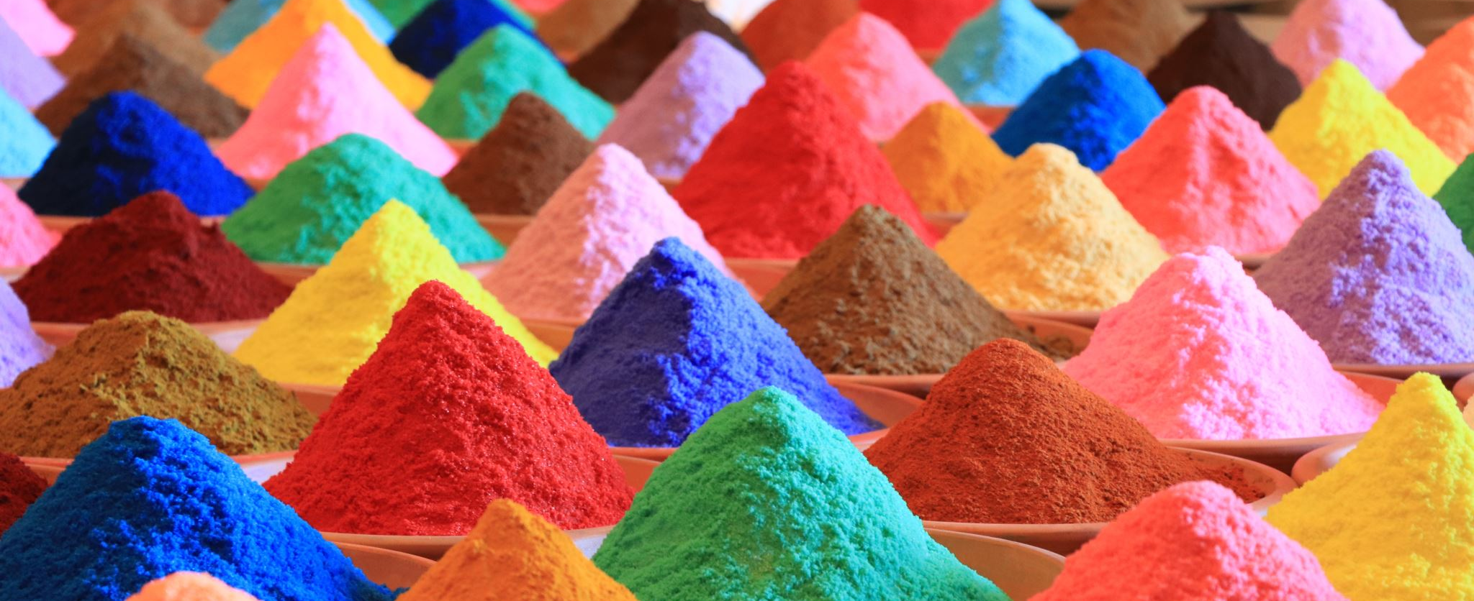
Changing Demographics
Most institutions of higher education have a majority female population.
Browning of America has begun.

Slide 9
What Can We Do to Achieve Our DEI Goals?

Slide 10
Creating the Environment
1. Hold workshop(s) to discuss goals of DEI for the organization.
2. Establish a goal for program committees to include activities that demonstrate commitment to DEI.
3. Invite those you’d like to include to discuss the goals and glean their interest.
4. Continue to talk about commitment and translate talk into actions.

Slide 11
Questions

